Slide 1
Ghost Tunnel Data transmission based on WiFi covert channel
Chengqiang Jin,M.S.
College of Computer Science and Technology
Zhejiang University of Technology
king_jcq@163.com

Slide 2
Agenda
Introduction
Previous research on Ghost Tunnel
Ghost Tunnel implementation
Further application of Ghost Tunnel

Slide 3
Introduction
Air-Gapping
Attack payload

Slide 4
Air gapping
Air gapping
- Wikipedia: “air gapping is a network security measure employed on one or more computers to ensure that a secure computer network is physically isolated from unsecured networks, such as the public Internet or an unsecured local area network. The name arises from the technique of creating a network that is physically separated (with a conceptual air gap) from all other networks.”
Air gapping aims to avoid the intrusion and data leakage
through network connections

Slide 5
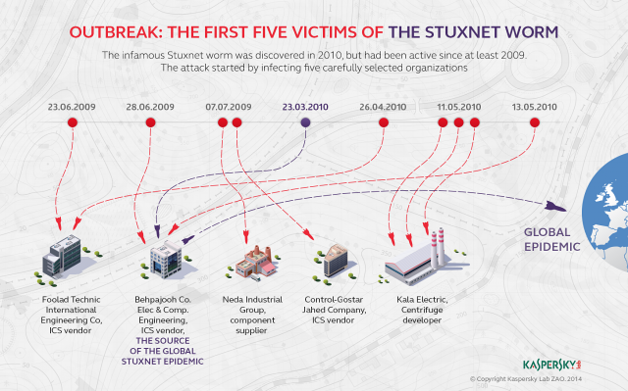
Stuxnet Worm(2010)
Attacking initiated viaan infected USB drive
Designed to attack the Yilan nuclear

Slide 6
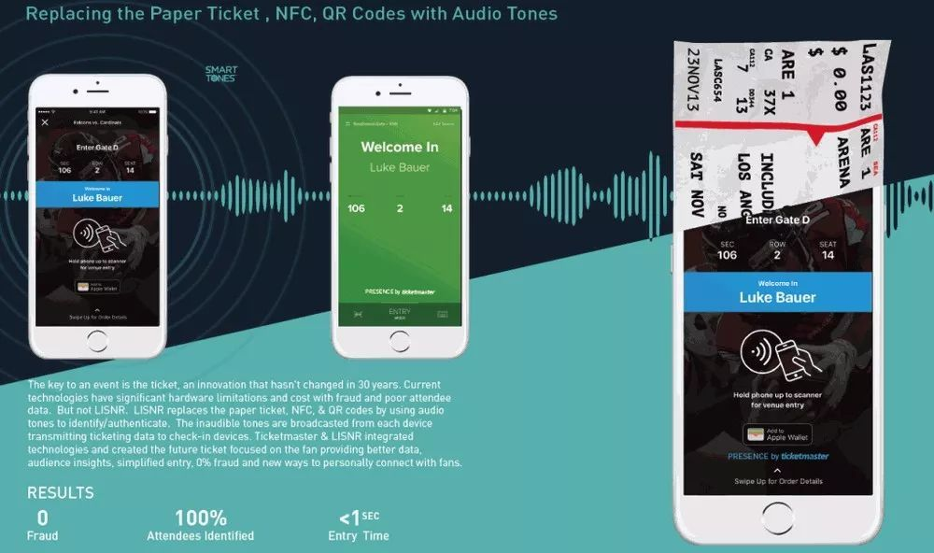
Attack Payload - 1
Transmission of data using infrasonic waves or ultrasonic

Slide 7
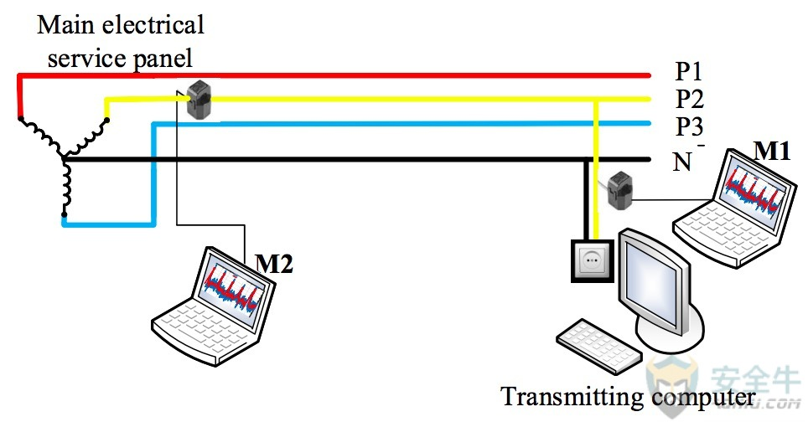
Attack payload – 2
Stealing computer data from a power line

Slide 8
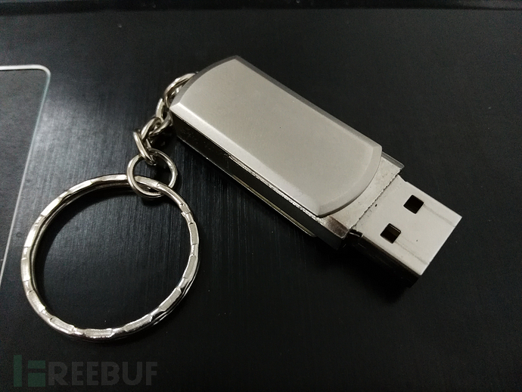
Attack payload – 3
HID attack

Slide 9
Previous research on Ghost Tunnel

Slide 10
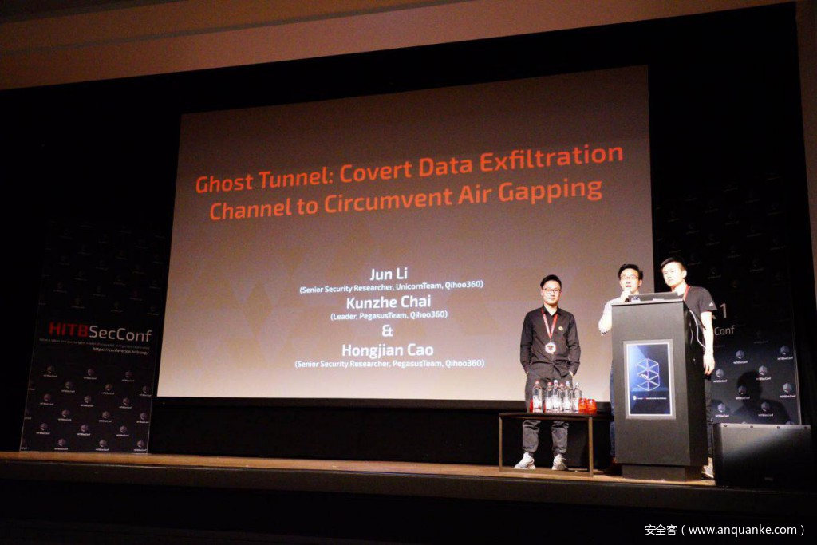
PegasusTeam, 360 Security Technology

Slide 11
Comman WiFi Connection

Slide 12
Ghost Tunnel – No WiFi Connection
A covert WiFi channel using Beacon, Probe Request, Probe Response
A special SSID as the identifier

Slide 13
Ghost Tunnel implementation

Slide 14
Beacon帧结构
Beacon/Probe Response

Slide 15
Probe request帧结构
Probe Request

Slide 16
Through Operating System WiFi API
Windows
- Native Wifi API
Mac OSX
- coreWLAN
Linux
- nl80211 & libnl

Slide 17
Windows Platform
DWORD WINAPI WlanScan(
_In_ HANDLE hClientHandle,
_In_ const GUID *pInterfaceGuid,
_In_opt_ const PDOT11_SSID pDot11Ssid,
_In_opt_ const PWLAN_RAW_DATA pIeData,
_Reserved_ PVOID pReserved );
DOT11_SSID pDot11Ssid
uSSIDLength | ucSSID(payload)
WLAN_RAW_DATA pIeData
dwDataSize | ElementID | Length | Information(payload)

Slide 18
Hostapd
Vendor element
ElementID(dd) | Payload Length | Payload

Slide 19
插入捕获数据图片

Slide 20
Further application of Ghost Tunnel

Slide 21
transfer files

Slide 22
fragmentation
ElementID(dd) | Payload Length | Payload
ElementID(dd) | Payload Length | Total Fragment | Fragment ID | Payload
理论长度计算

